Slide 1
Extracting Training Data from Diffusion Models
Presenter: Kim Seung Hwan (overnap@khu.ac.kr)

Slide 2
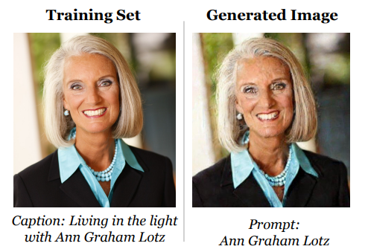
Models memorize data
Carlini et al. arxiv: 2301.13188
Diffusion models memorize and regenerate the training data
But in my thought, diffusion is not important

Slide 3
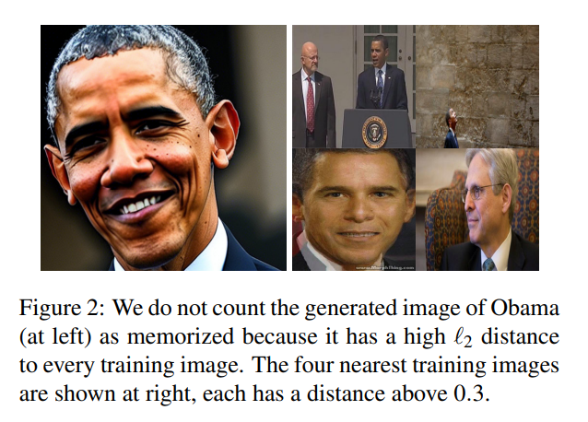
What is “memorize?”

Slide 4
Method
1. Generate many examples in the standard manner
2. Perform membership inference
Membership Inference: Check whether the data has been trained or not

Slide 5
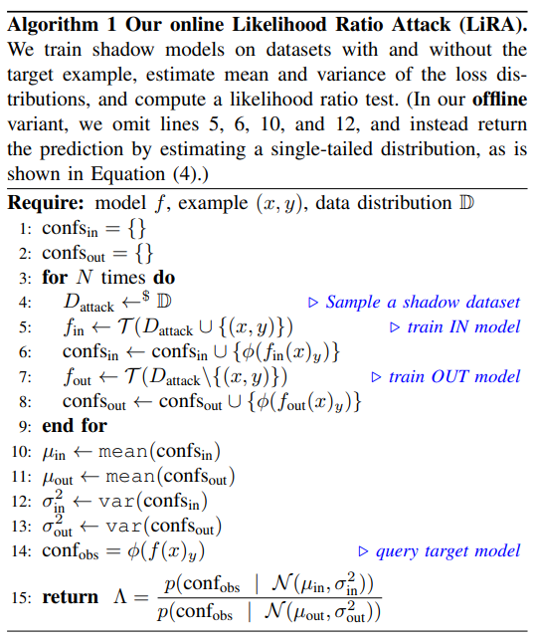
Method
There are several ways to do membership inference
Easy way: Naively check the output of model
SOTA: Estimate the distribution of ‘shadow models’ trained with and without the target sample (LiRA)

Slide 6
Method
The authors use an interesting heuristics
Group samples that are close in metric from each other (form a graph)
Then, find cliques among them
Clique: complete subgraph

Slide 7




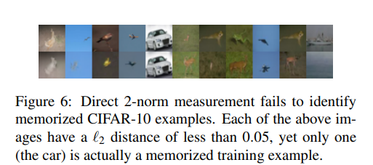

Method
This is an enhancement of the existing ‘paring’ method
Due to the limit of distance metrics such as L2,
Human-cognitively dissimilar samples may be considered the same
Same in L2 space!

Slide 8
Method
Simple paring can group dissimilar samples as same
Predict by cliques, this happens very rarely
This becomes even more so as the size of the clique increase
This is very rare

Slide 9
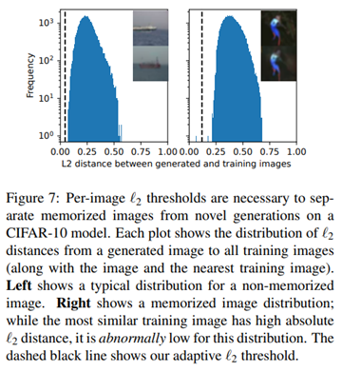
Method
Still there are limitations
The L2 distance varies greatly depending on backgrounds, etc.
The authors measured L2 for each patch and takes max values

Slide 10
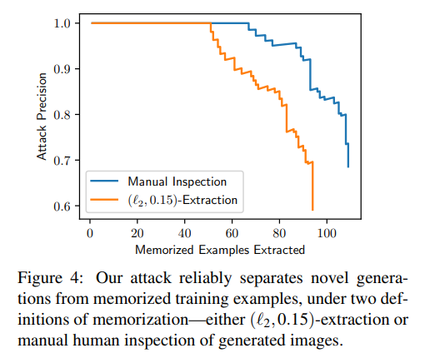
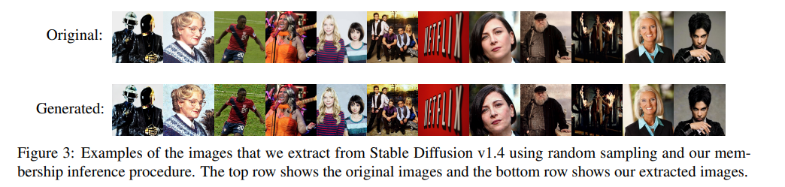
Result
If the model keeps recreating the same sample over and over,
It is likely a memorized sample
350,000 prompts * 500 samples
= 175 million

Slide 11
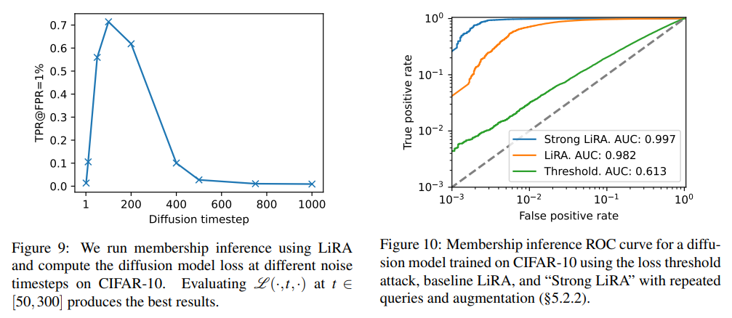
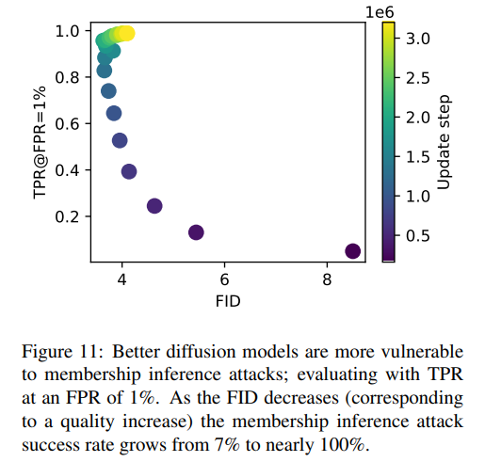
Result
Other notable results…

Slide 12
Limitation
There may be samples that the model does not repeatedly create but remember
That is, the likelihood is low but the mode exists in model distribution
The sample is generated with very low probability,
But will be identical to the sample in training data
This is “memorized”, but should we treat them as a problem?

Slide 13
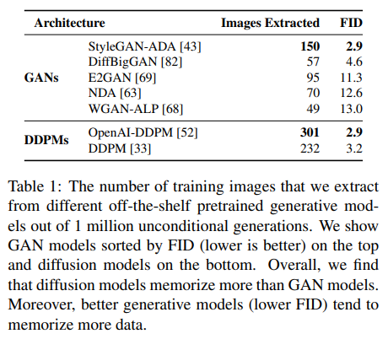
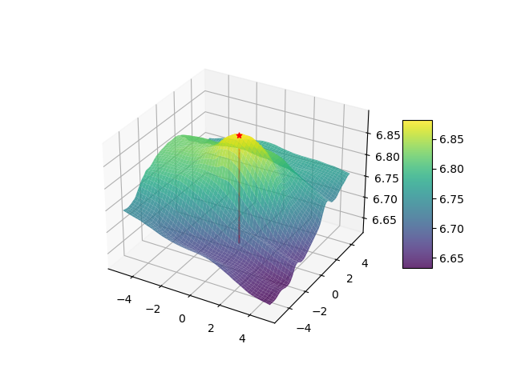


Limitation
They choose prompts from examples that appear repeatedly
Typical samples will be very difficult to obtain
Must generate a ton of sample to find the cliques
Finding cliques is NP-complete problem
The trained data (I thought it’s significant)
A model’s output
A plane in the data space (no dimensionality reduction!)

Slide 14
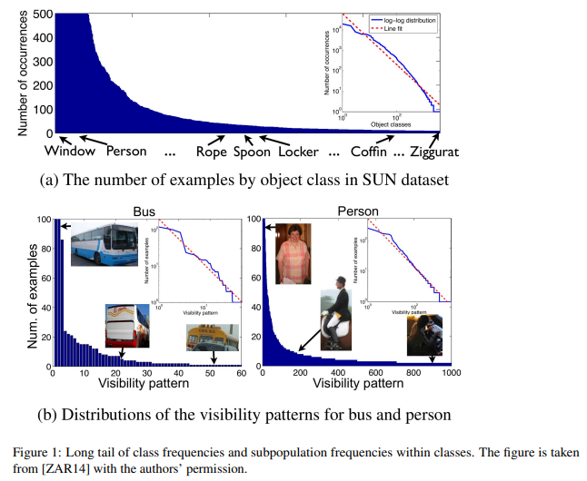
Further Reading
Vitaly Feldman. Does learning require memorization? A short tale about a long tail. In ACM SIGACT Symposium on Theory of Computing, 2020.
Models has no choice but to remember samples to obtain optimal generalization performance
In the case of long-tailed data, the model cannot distinguish whether the tail data is rare or an outlier
So it must be memorized for optimal performance
Including a large amount of mathematical proof 😭

Slide 15
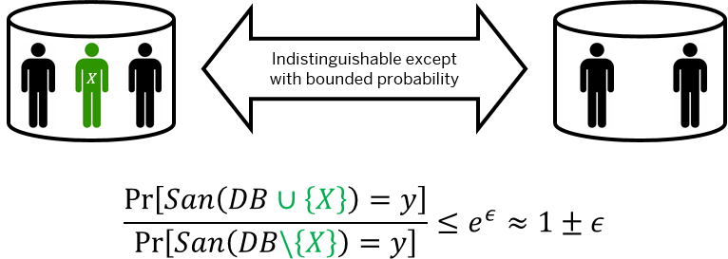
Further Reading
Martín Abadi, Andy Chu, Ian Goodfellow, H Brendan McMahan, Ilya Mironov, Kunal Talwar, and Li Zhang. Deep learning with differential privacy. In ACM CCS, 2016.
Differential Privacy – DP is used in the database field
Techniques for preserving privacy
I have not read this paper, but it is interesting
The key idea is that the output ratio of the function for datasets that differs by only one sample must be less than epsilon

Slide 16
Thank you for listening
Presenter: Kim Seung Hwan (overnap@khu.ac.kr)

